Slide 1
assignment 5:
sketching, low-fi prototyping & pilot usability testing
Lifelong Learning 2:30–4:20 PM
Team 2: Seamus, Fred, Jailia, Ashton

Slide 2




our team
Seamus
Fred
Jailia
Ashton
Public Policy
Economics
Computer Science
Computer Science

Slide 3
01.
05.
Low-fi Prototype: Task Flows
Project Overview
Sketching Explorations
02.
Testing Methodology
06.
03.
Selected Interface
07.
Testing Results
04.
Low-fi Prototype: Construction
08.
Discussion
table of contents

Slide 4
01.
project overview

Slide 5
problem + solution
problem
solution
A collaborative office hours tool streamlining instructor scheduling and peer-to-peer learning by grouping students and enabling collaboration either in person or through the app with clear group connections and voice/chat features.
Lengthy office hours wait times create inefficiencies for instructors and unproductive waiting for students.

Slide 6
project overview
project title
one-liner
value proposition
Unlock the potential of collaborative learning and and efficient office hours with sameQ. Empowering educators to offer flexible office hours and enabling students to seamlessly book individual or group slots while facilitating connections with peers, sameQ helps to foster a vibrant learning community and enhanced academic success.
“Questions shared, knowledge paired.”
sameQ

Slide 7
02.
sketching explorations

Slide 8
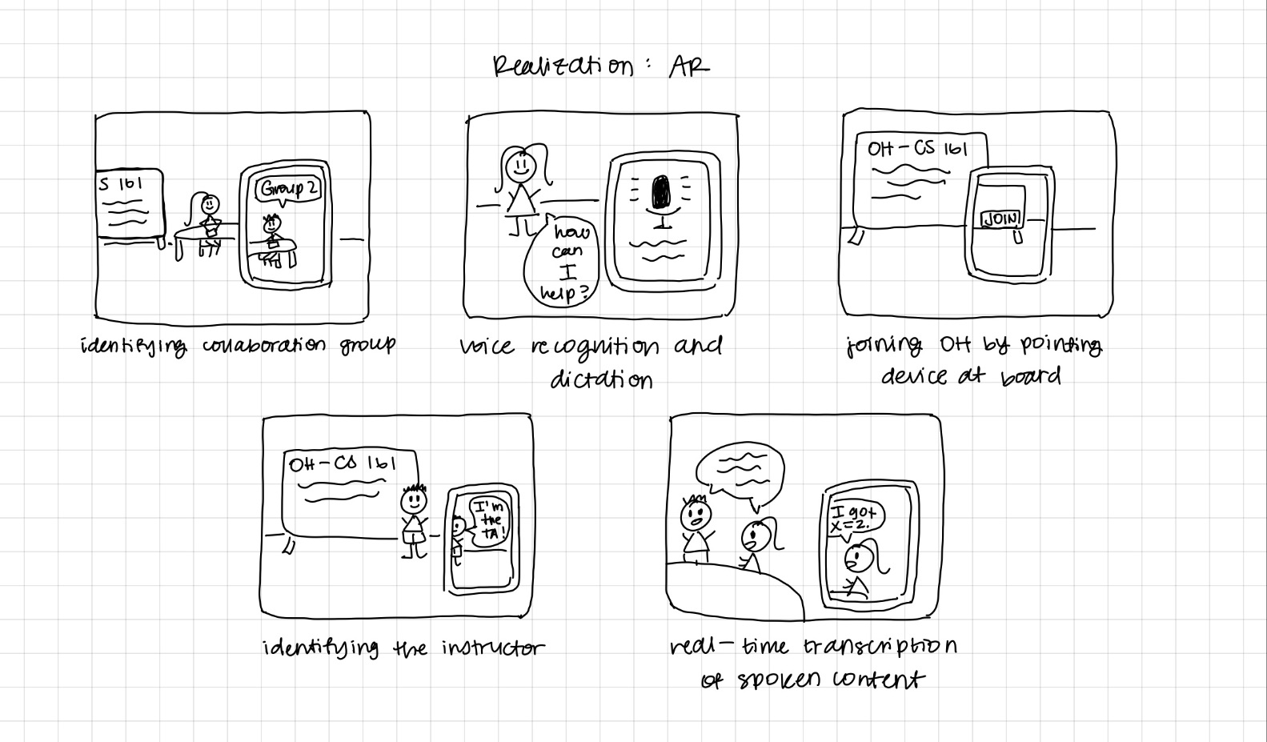
realization #1
Figure 1: Concept sketches for an AR application

Slide 9
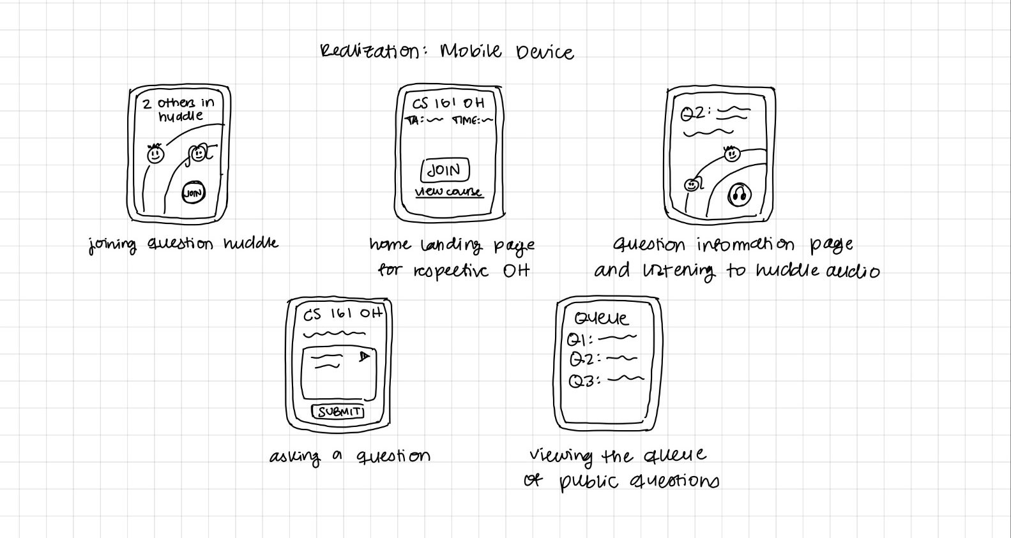
realization #2
Figure 2: Concept sketches for an mobile device application

Slide 10
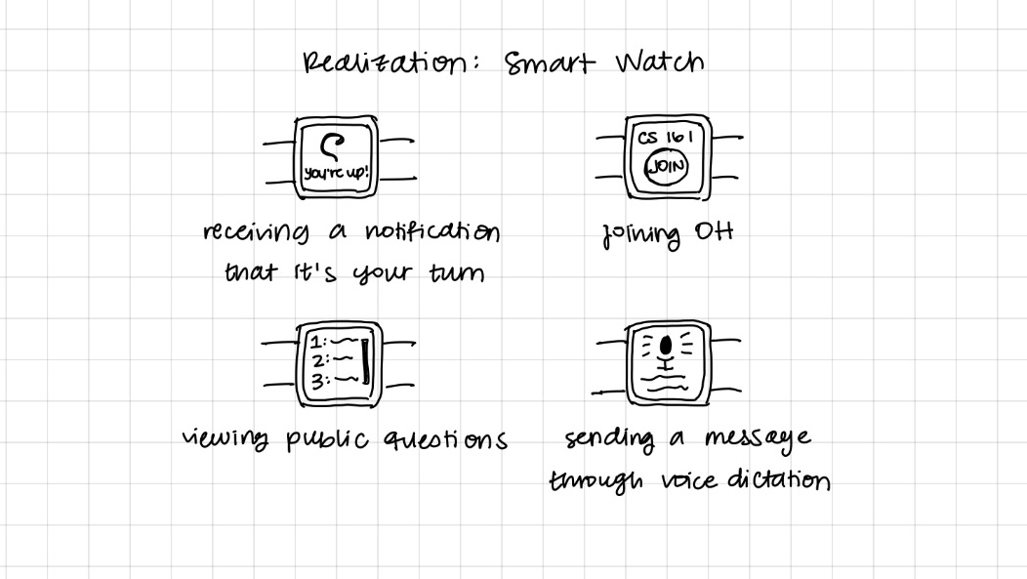
realization #3
Figure 3: Concept sketches for a wearable

Slide 11
moving forward with AR and mobile
Wearable application could be an extension of mobile application.

Slide 12
03.
interface & rationale

Slide 13
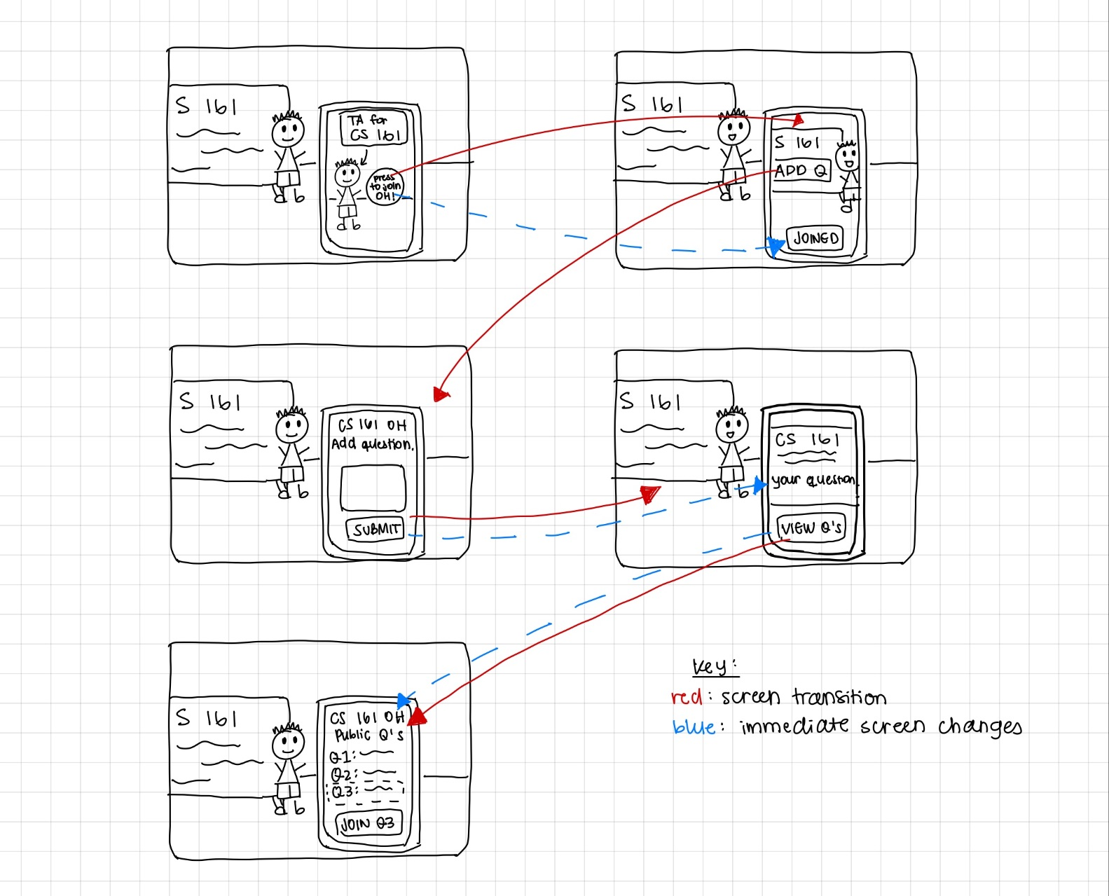
Figure 4: AR app screen transitions (joining session, asking a question, viewing public questions)
realization #1

Slide 14
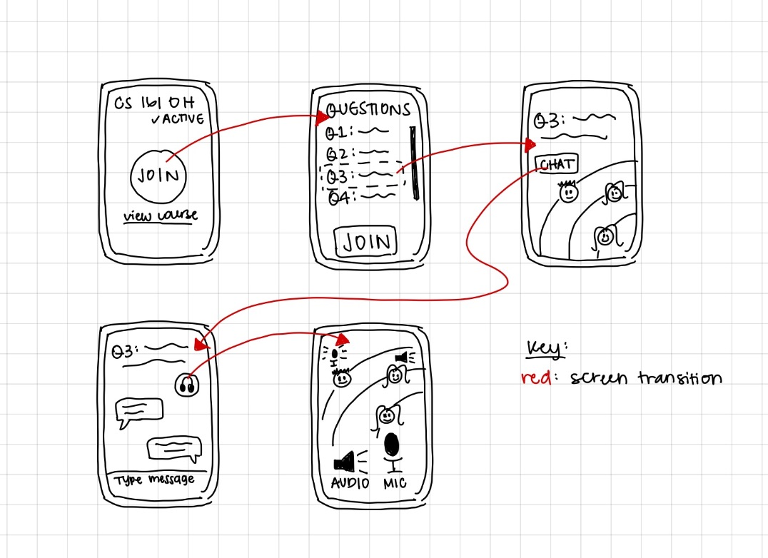
Figure 5: Mobile app screen transitions (joining session, chatting, joining huddle chat)
realization #2

Slide 15
choosing an interface
AR
Mobile
Pros
Immersive collaboration
Visual learning
Hands-free learning
Cons
Device compatibility
Learning curve
Privacy concerns
Pros
Accessibility
User familiarity
Remote learning
Cons
Screen size constraints
Distractions
Applicability
Notes:
AR
Immersive collaboration: Students can all always feel like they are together in-person → Creates a more interactive and immersive learning experience
Visual learning: AR can enhance visual learning through overlays, models, popups
Hands-free learning: AR enables hands-free learning (like through AR glasses) → Allows students to interact and engage with content/peers more easily
Device compatibility: AR apps require very specific, advanced hardware → Limited access, especially considering whether schools would be providing the hardware
Learning curve: People have little to no experience with AR → Difficult to learn and barrier to adoption
Privacy concerns: Considering minors and educational settings, camera and location tracking raises privacy concerns
MOBILE
Accessibility: Mobile apps can run on many devices across multiple platforms (like phone or tablet, Android or iOS) → Broader audience can access
User familiarity: Many people are familiar with using mobile apps → More likely to adopt new app
Remote learning: Students are able to collaborate and use app to learn remotely → Offers greater flexibility and encourages greater use of the app
Screen size constraints: Mobile apps perform on smaller screens → Less content can be displayed, certain interactive features (like drawing) can be more difficult
Distractions: Mobile apps can serve as a distraction → Could affect the focus and quality of collaboration between students
Applicability: App can be less applicable to certain fields (like chemistry) that require a lot of physical interaction, manipulation, working with models, etc. → Difficult to replicate through solely a screen, no physical interaction capabilities

Slide 16
choosing a mobile interface - rationale
1
2
3
Accessibility and user base
Almost everyone has a smartphone
Simpler to implement new features
User familiarity
Familiar with mobile app interfaces
Well-established user experience
Learning curve
Learning environment
Various locations
Comfort and convenience
Changing circumstances
Notes:
Additional things to consider when choosing mobile interface:
Must consider the assumptions being made about students’ access to technology
Mobile phones not provided by schools, like Chromebooks or tablets are
Different backgrounds and experiences with technology → Different learning curves
How will parents view the use of this tool as a mobile app?

Slide 17
04.
low-fi prototype: construction

Slide 18
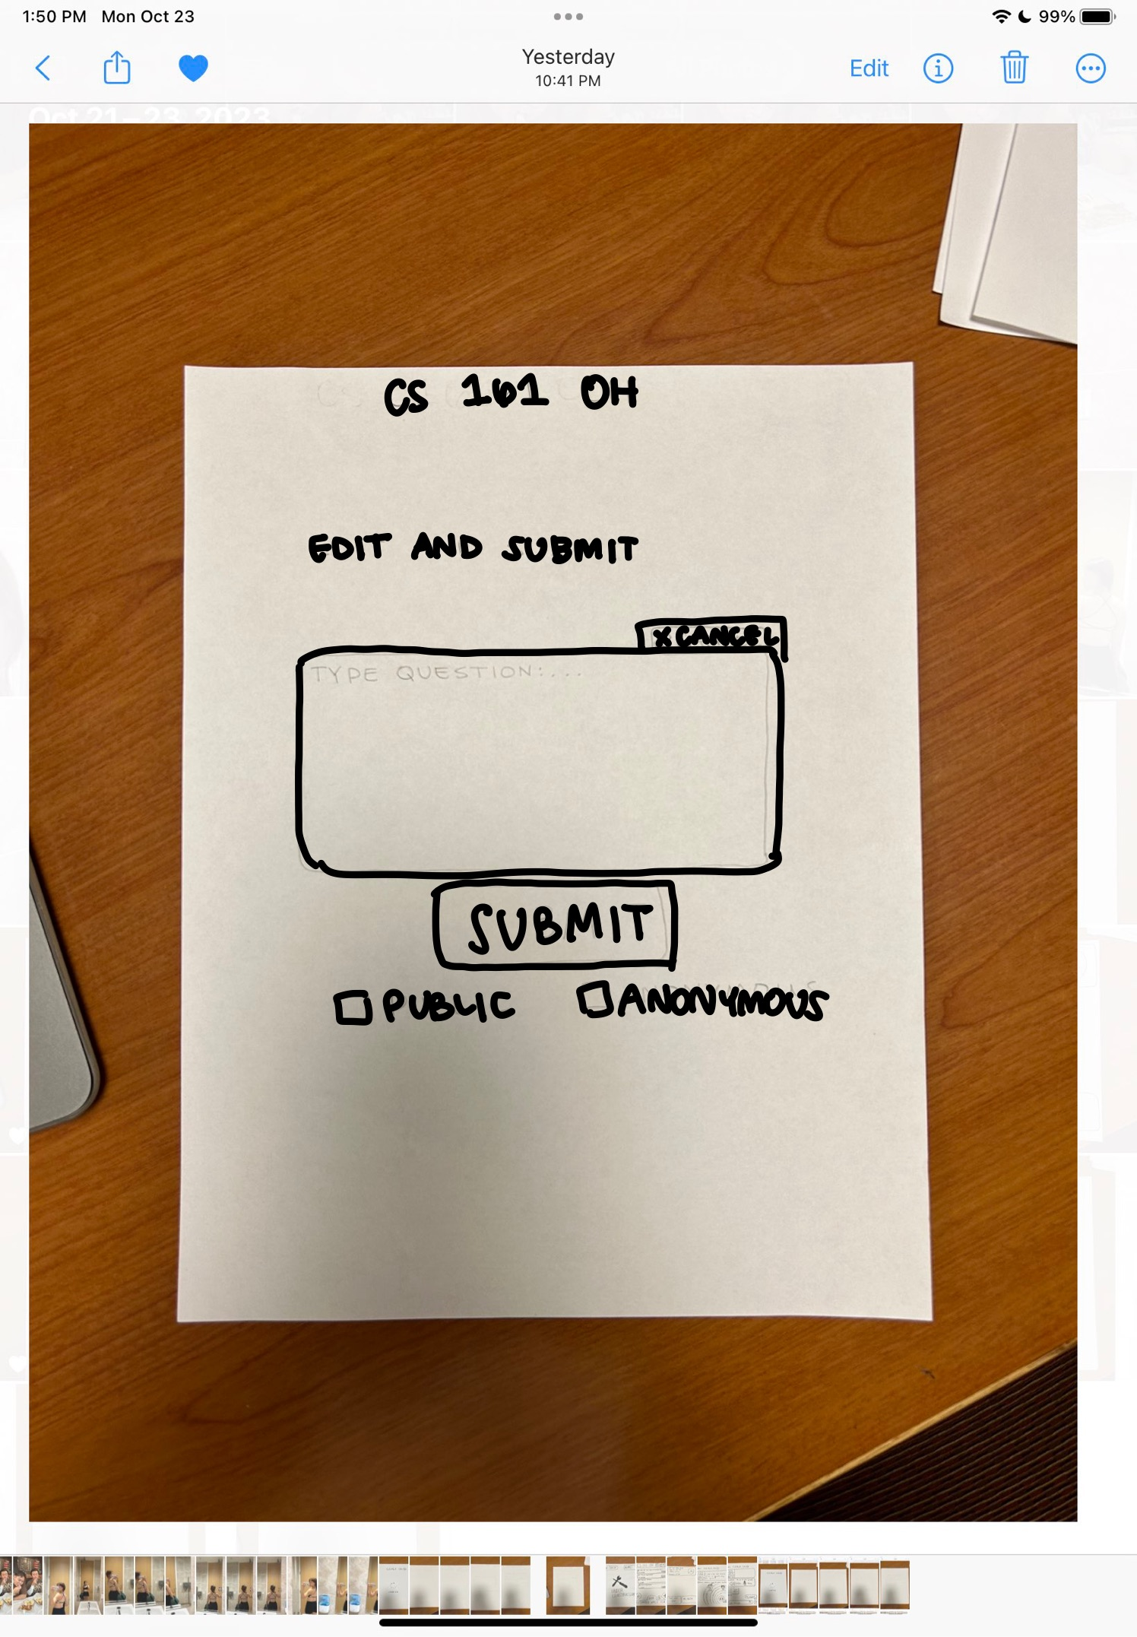
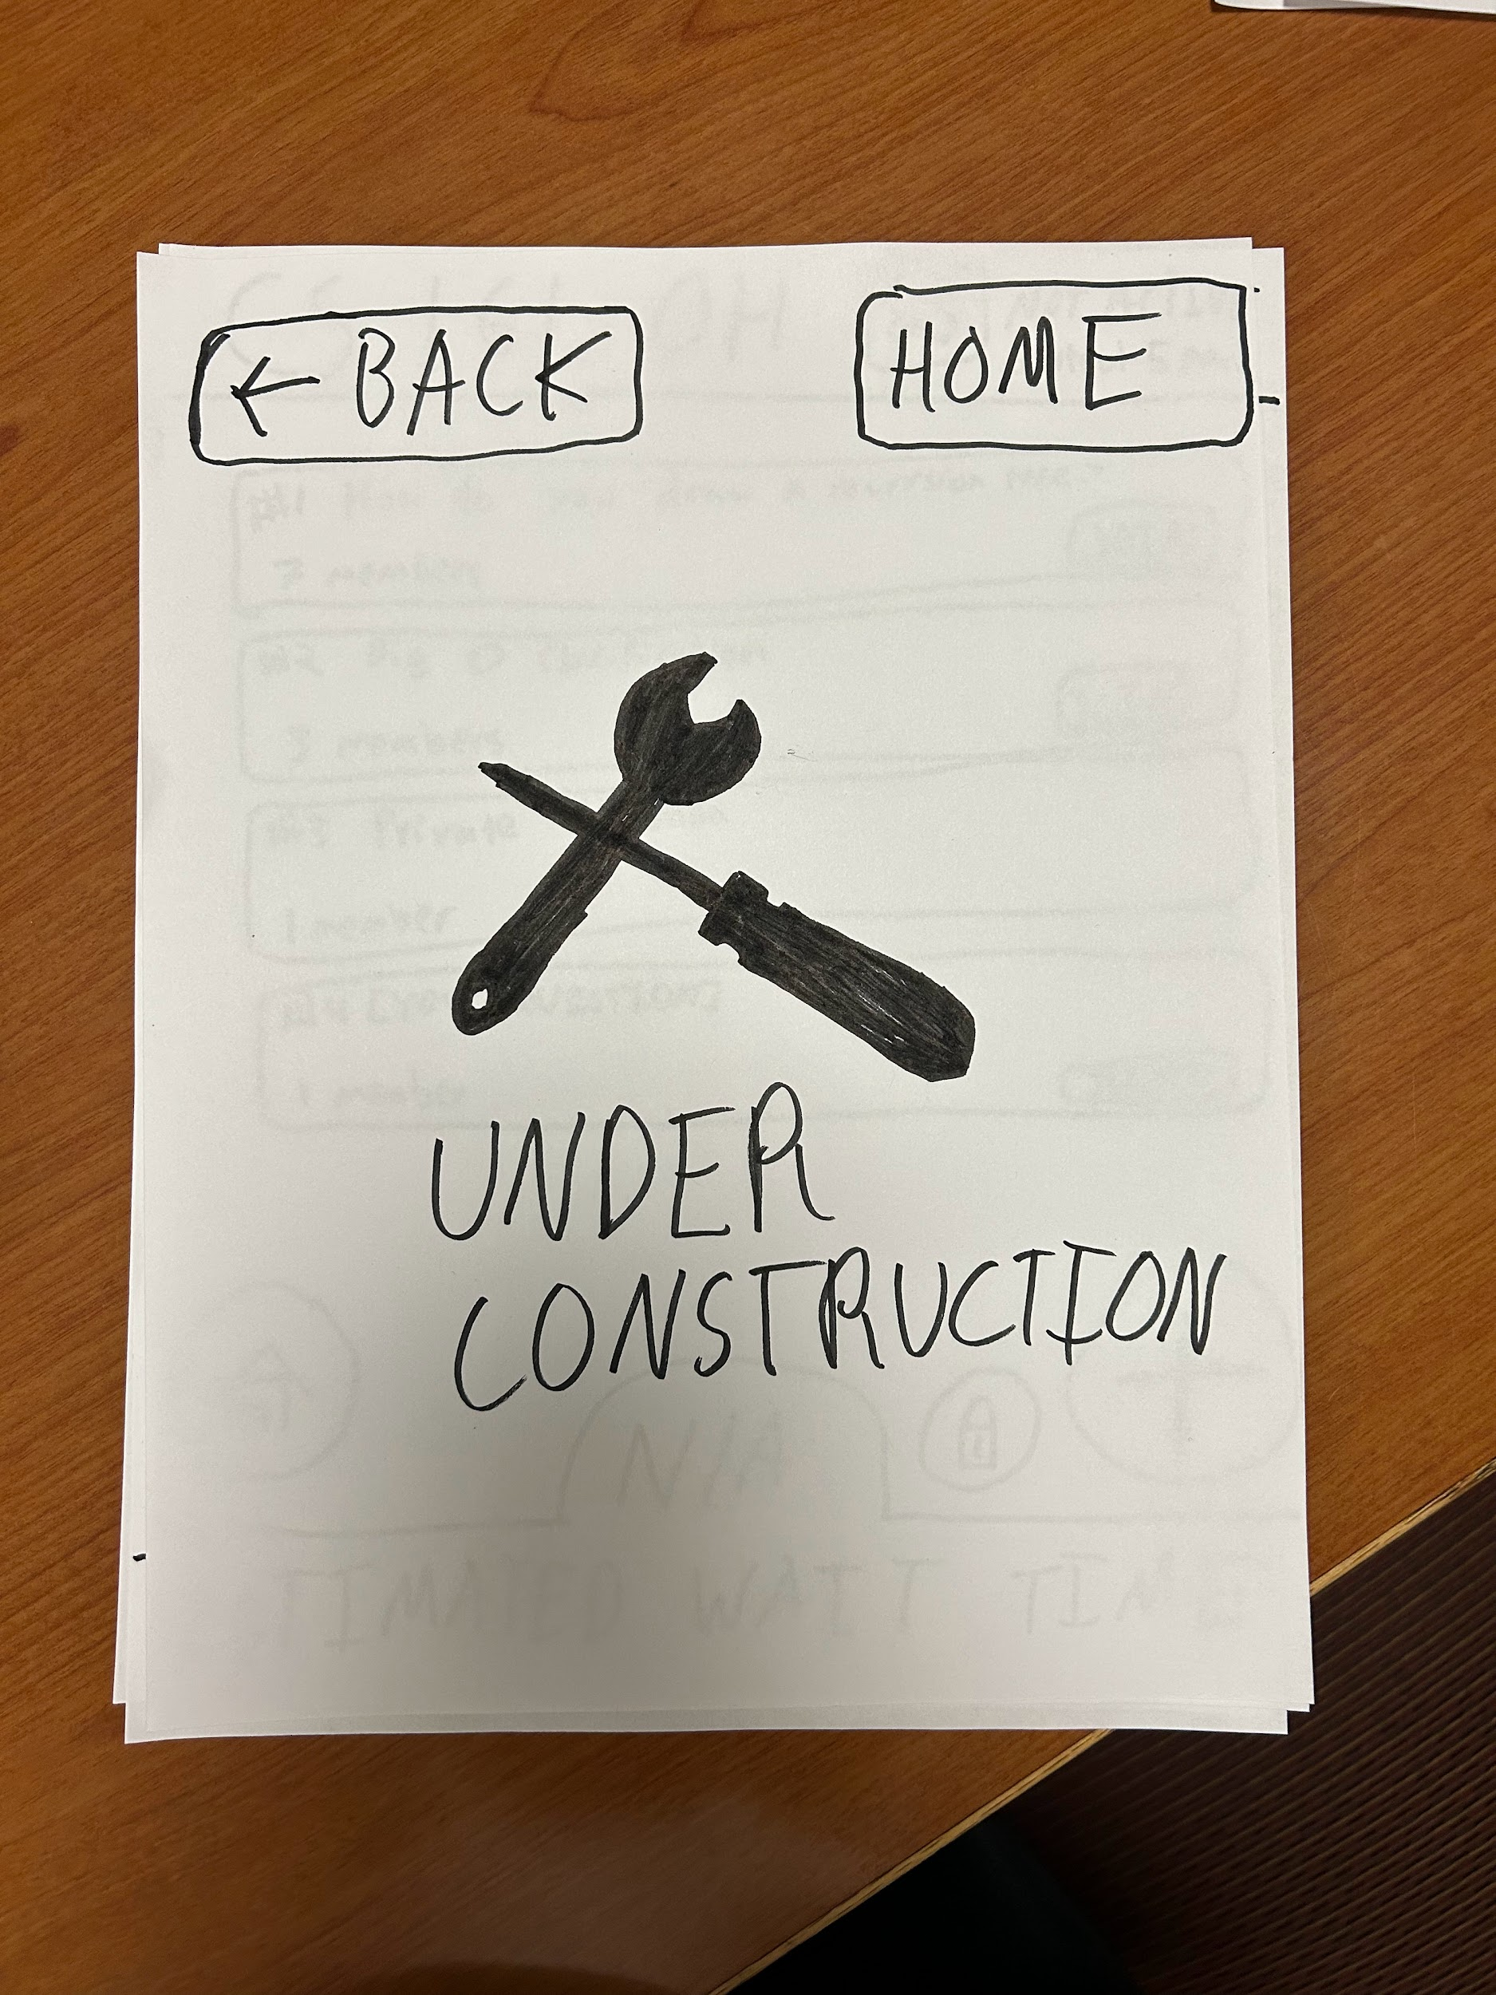
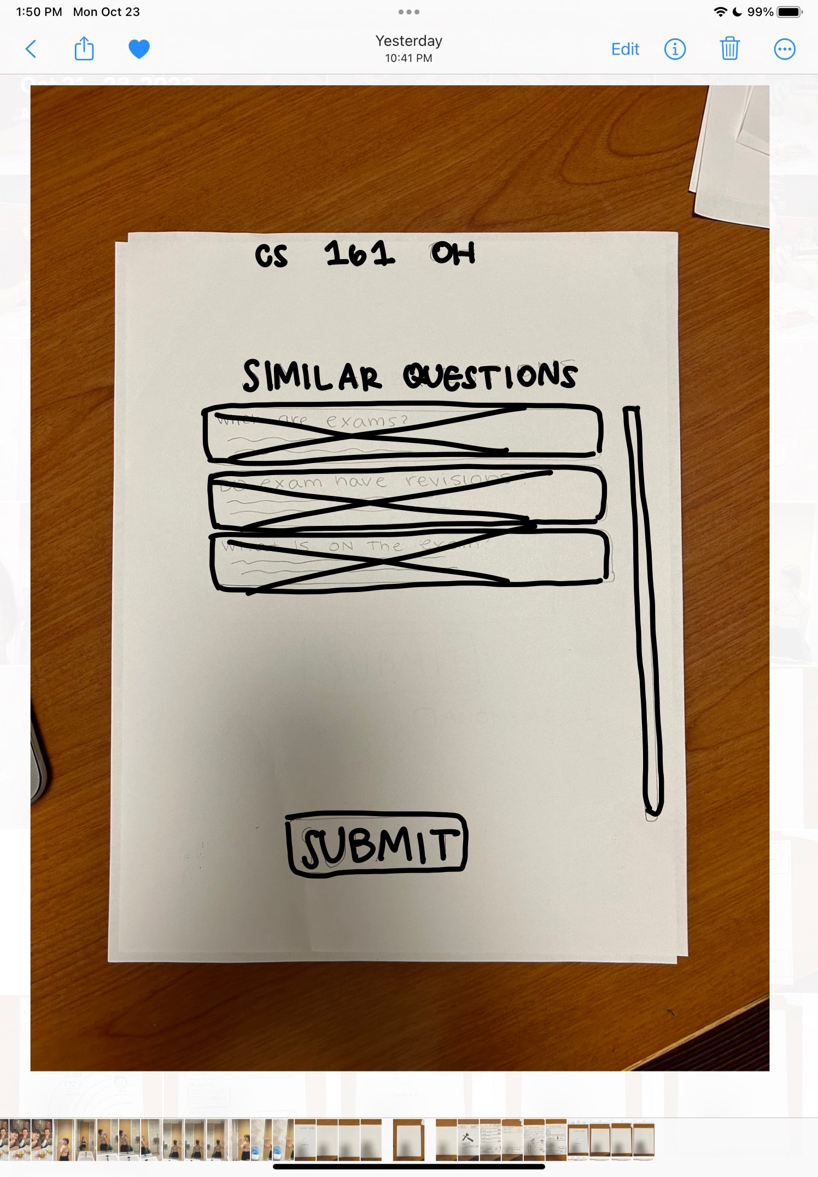
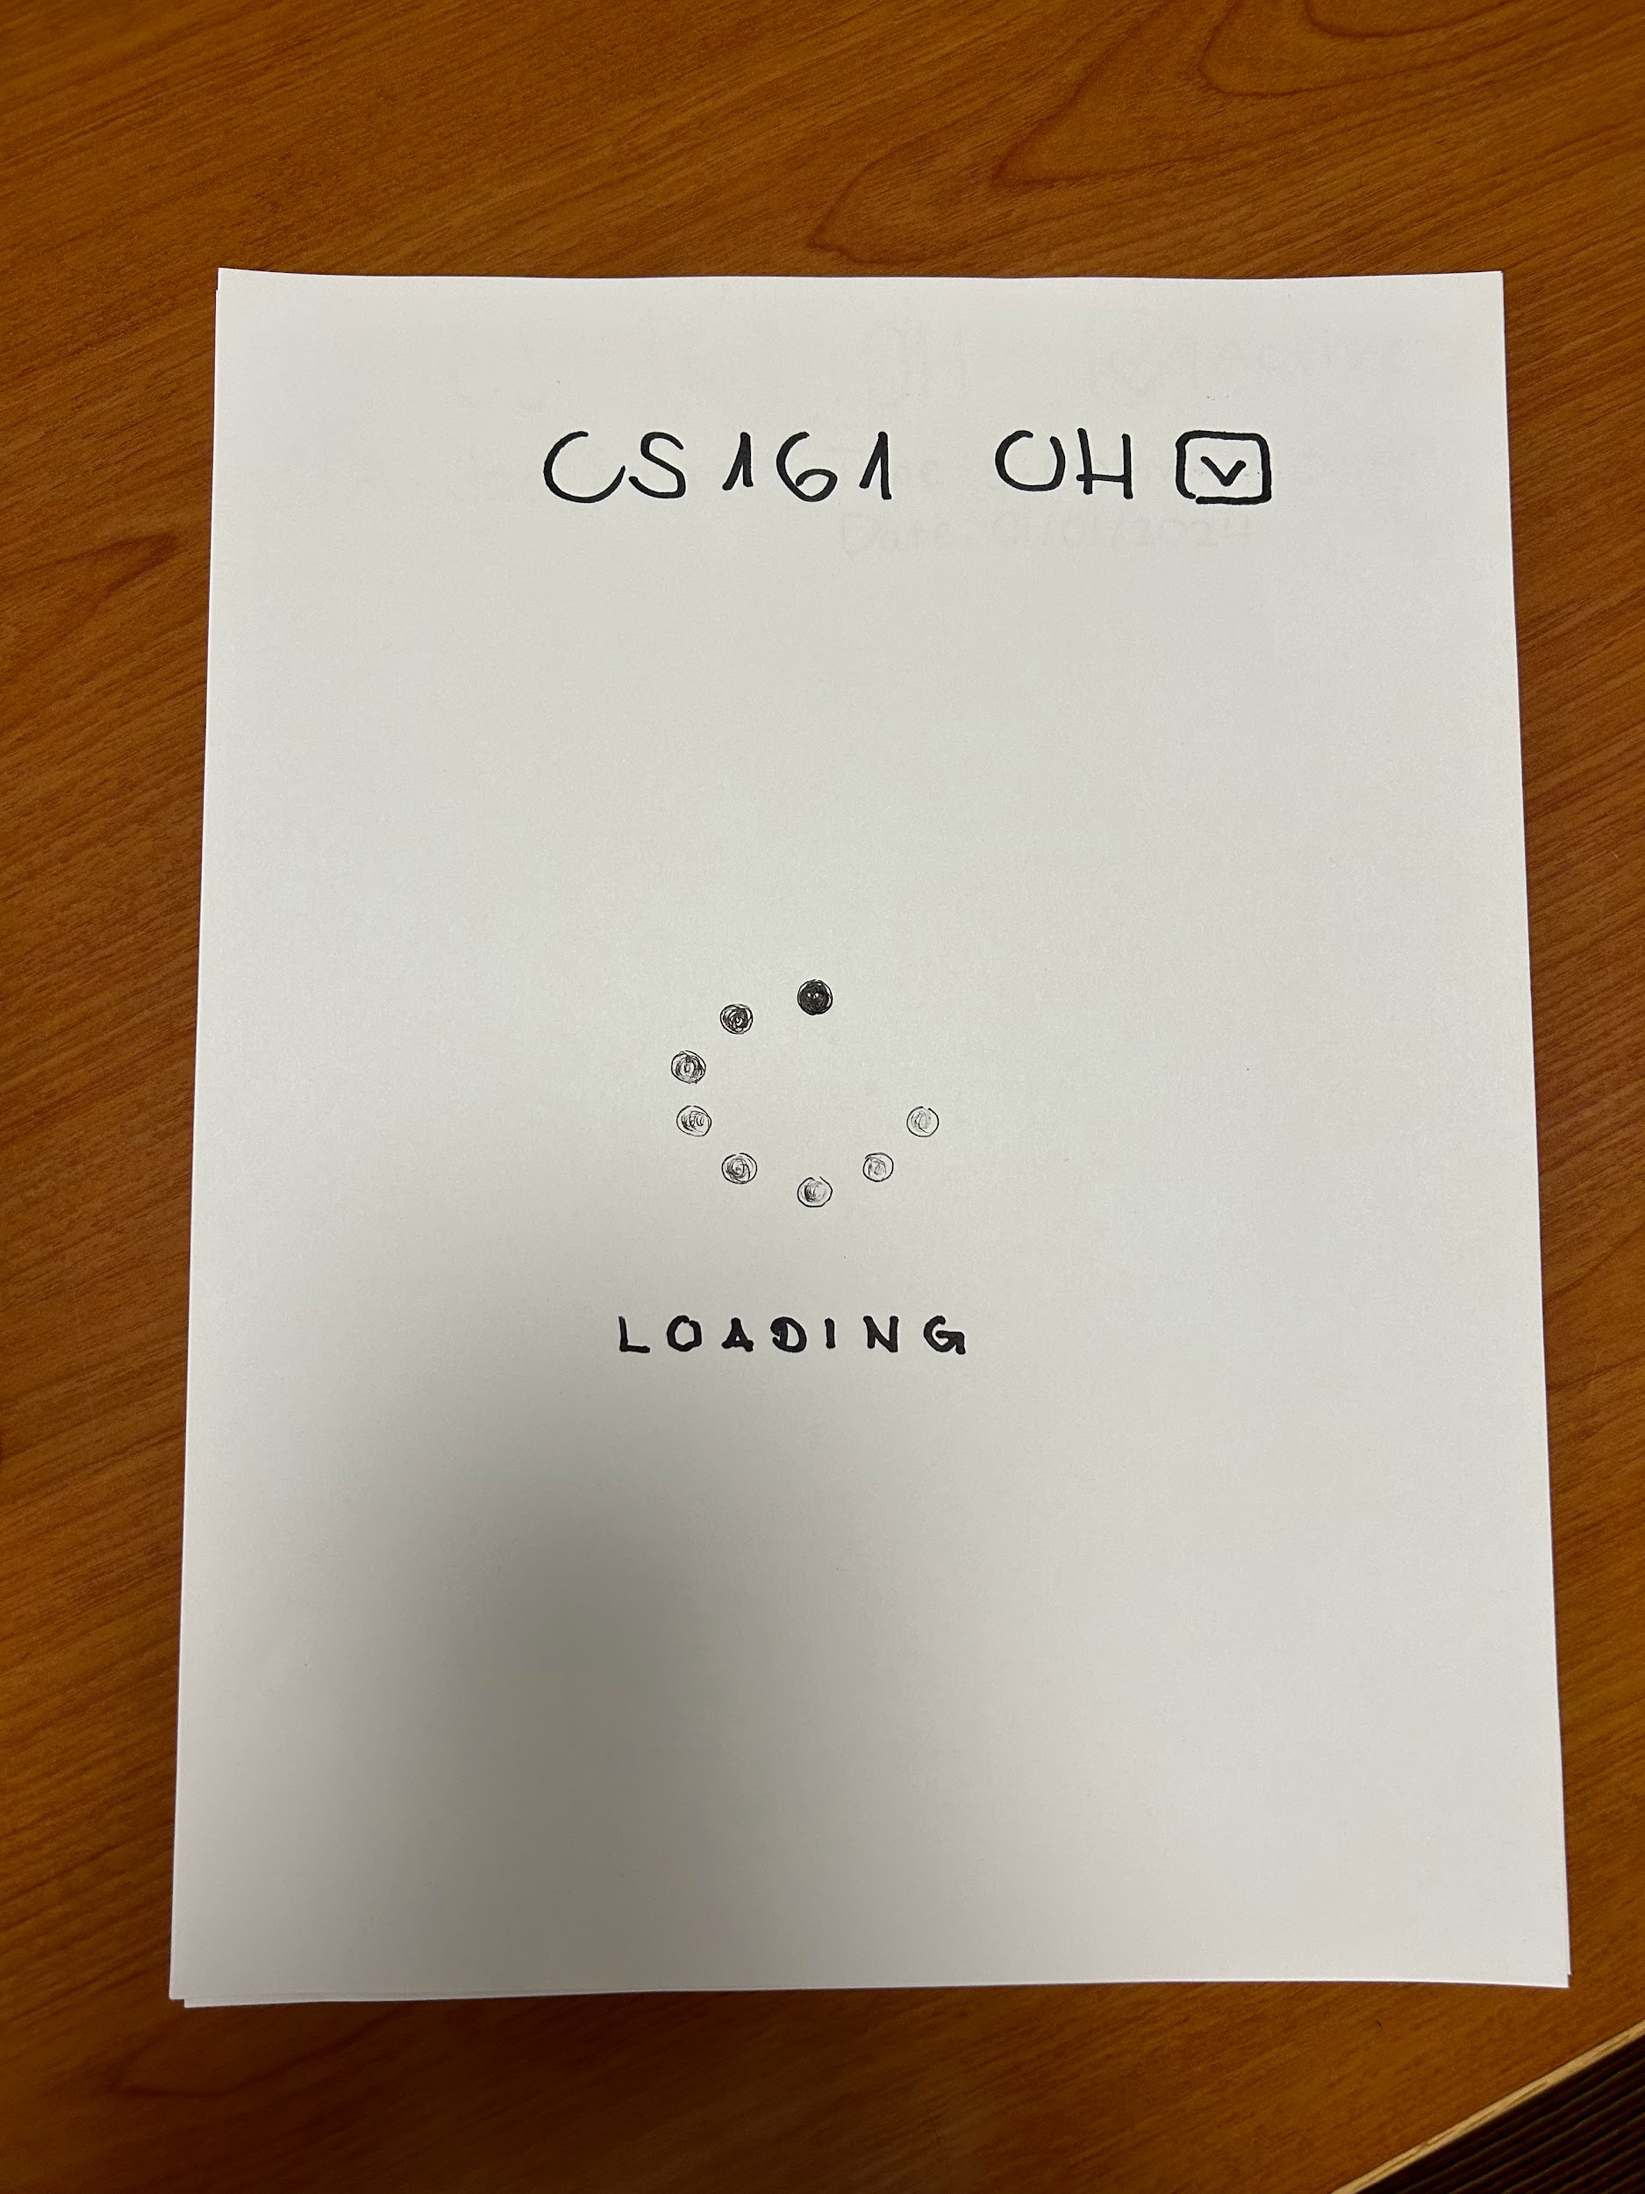
construction
Explored UI during studio
Defined scope and objective
Revisited UI using sketches and new ideas
Defined and incorporated task flows
Paper ⇒ Marvel
Notes:
Scope and objective: What do we want the main features of our app to be? How many options do we provide?
How would we feel if we were in the students shoes using this app → Consider both as HS and university students
Features: Want to emphasize the collaborative nature of app
What makes collaboration through our app different and more seamless compared to other methods?

Slide 19
05.
low-fi prototype: task flows

Slide 20
simple
Join an existing question.
moderate
Join the huddle for your question.
complex
tasks
Send a picture to a question’s huddle.

Slide 21
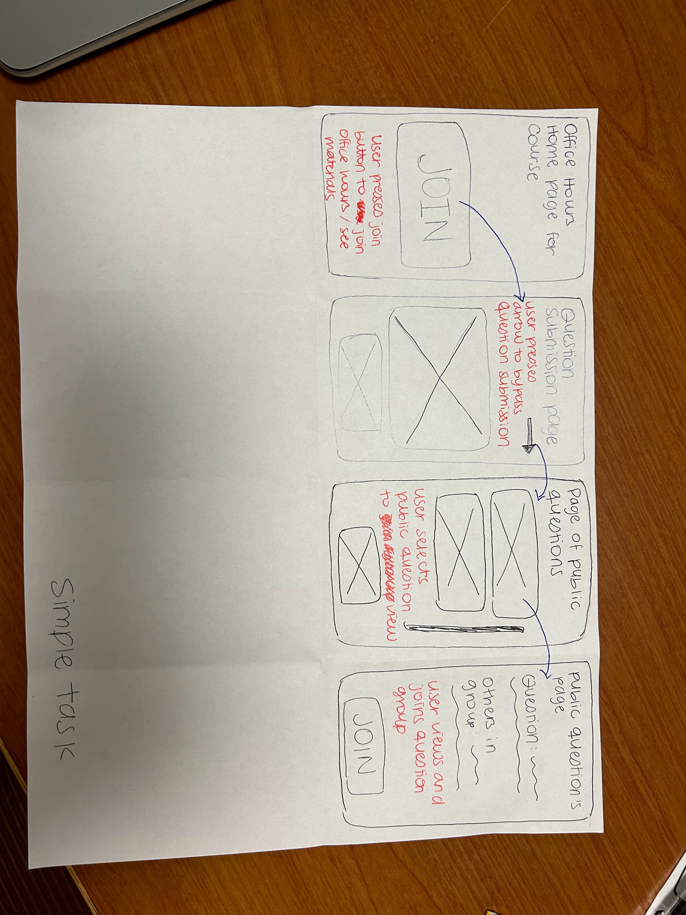
simple
Figure 6: Simple task of joining a public question.

Slide 22
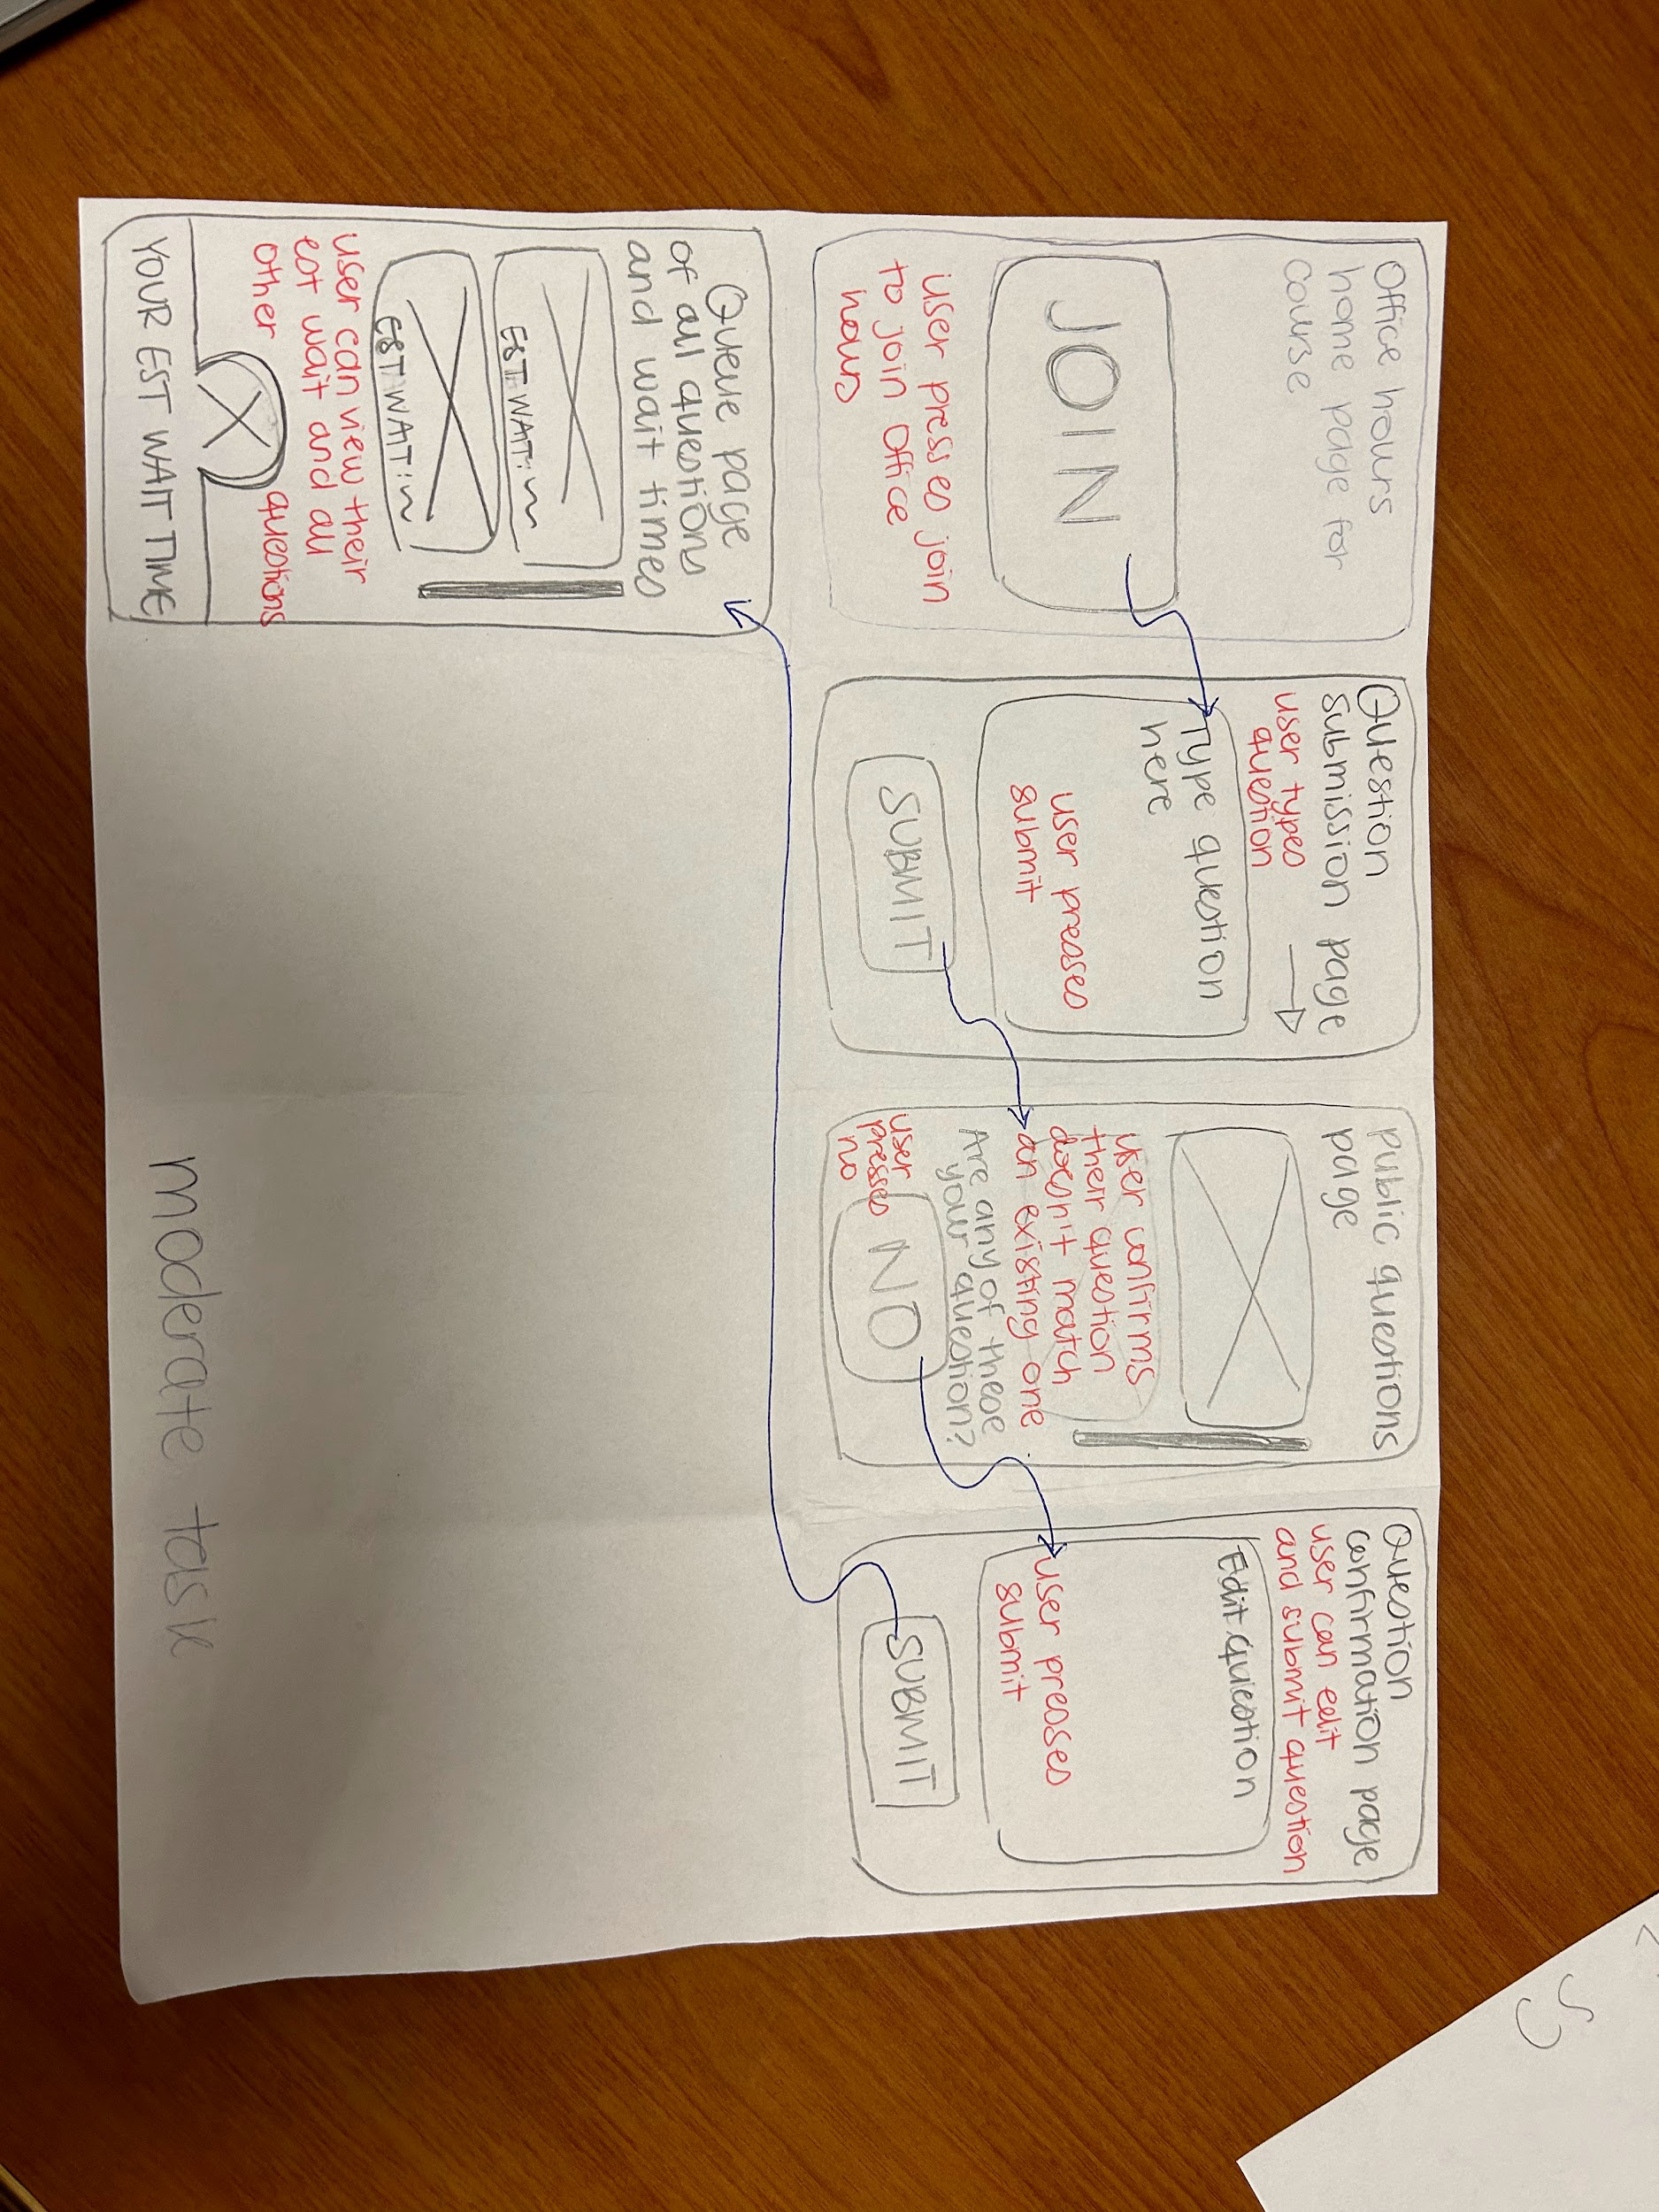
moderate
Figure 7: Moderate task of asking your own question and joining the huddle

Slide 23
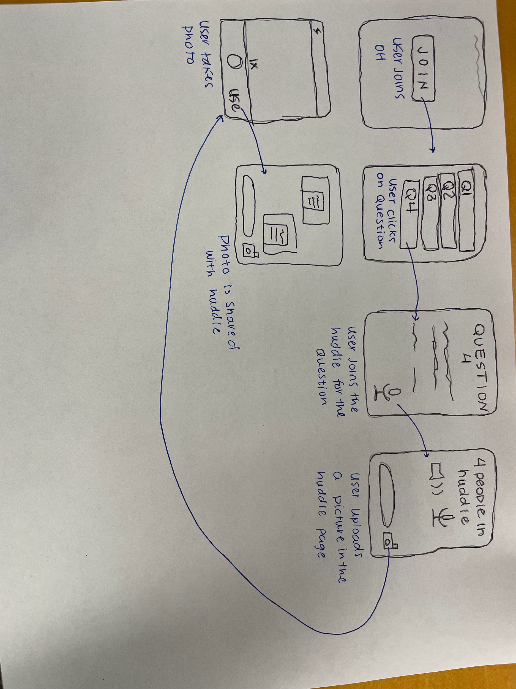
complex
Figure 8: Complex task of joining a huddle and sending a photo

Slide 24
06.
testing: methodology

Slide 25
participants
18 year old HS senior
Public school and community college in MN
Mutual friend
C
E
18 year old HS senior
Public school in GA
Mutual friend
University of Washington undergrad
Large general chemistry course
Friend of a sibling
J
F
Stanford undergrad
Student in dorm

Slide 26

methodology
environment & apparatus
procedure
goals & measurements
Overview of project and app
Explained testing – two rounds
Emphasized feedback and critique
Helped guide participants if necessary
3 on Zoom
Two devices/participant
Quiet areas
1 in person
Dorm common area
Efficiency
Time spent per task per round
Learnability
Number of errors per task per round
Notes:
Environment and apparatus
Zoom:
Can’t read facial expressions
Asking participants to narrate may be awkward
Quiet areas allowed participants to focus on app
In person:
Can read facial expressions and body language
Environment of common area may have affected how comfortable participant was narrating
Procedure:
What does “guiding” mean? What constitutes needing to step in?
Should we have explained what a “huddle” was beforehand?

Slide 27
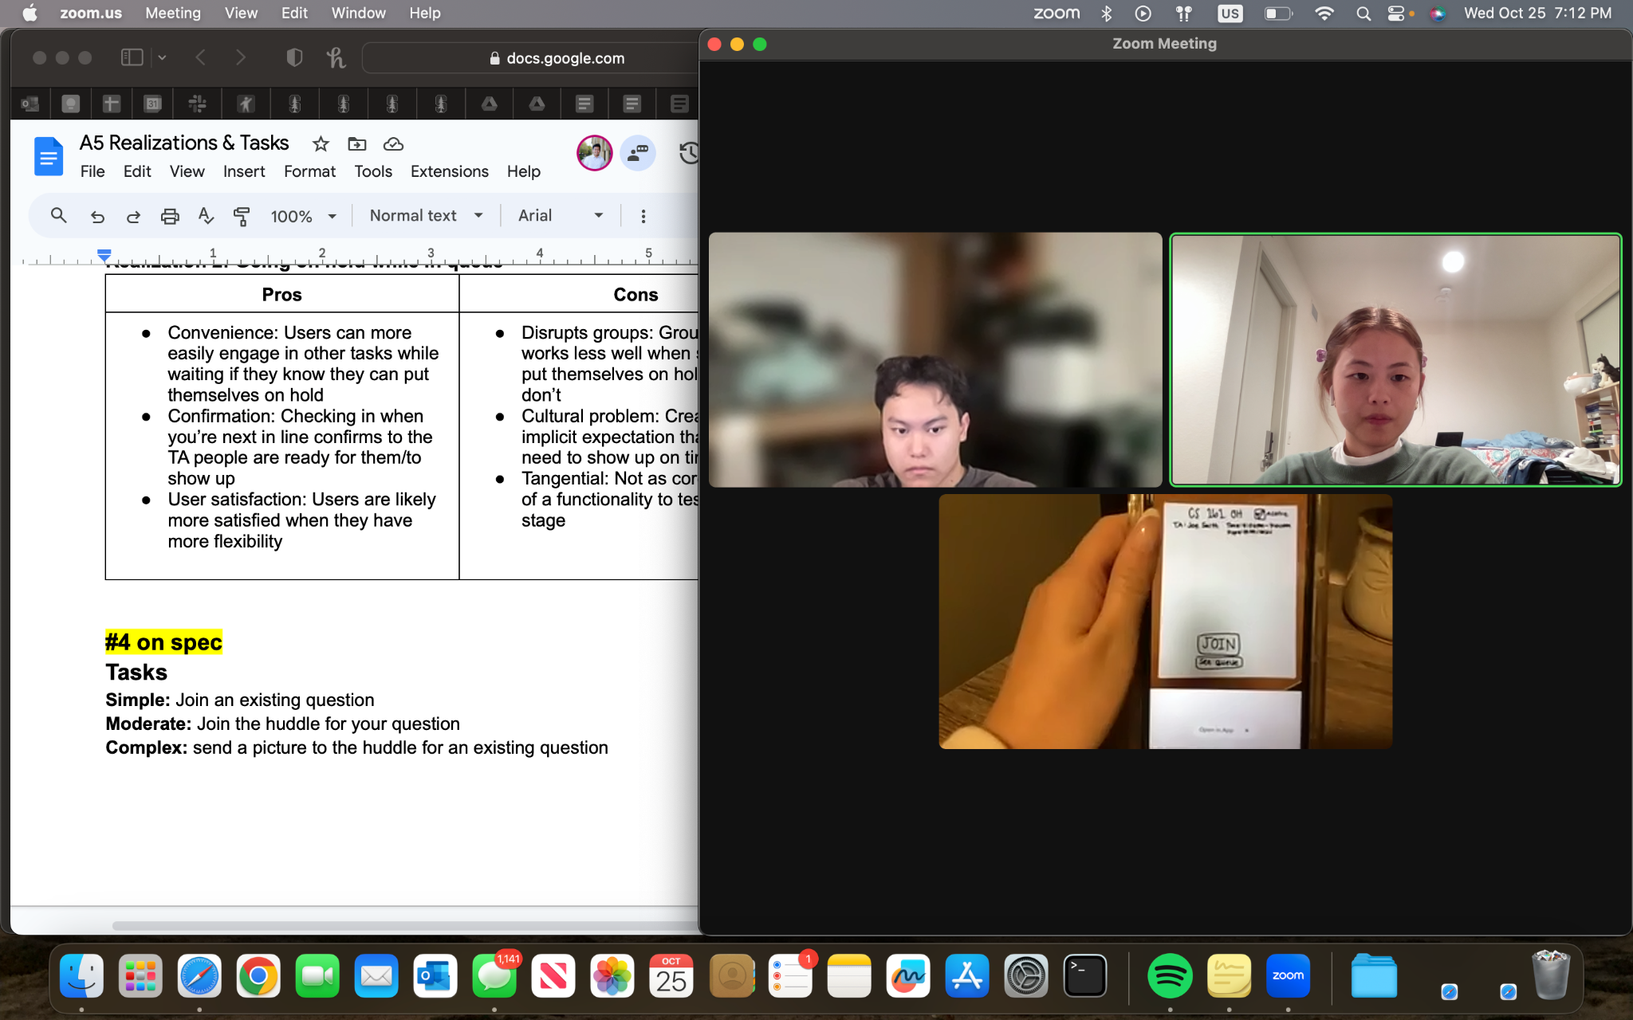
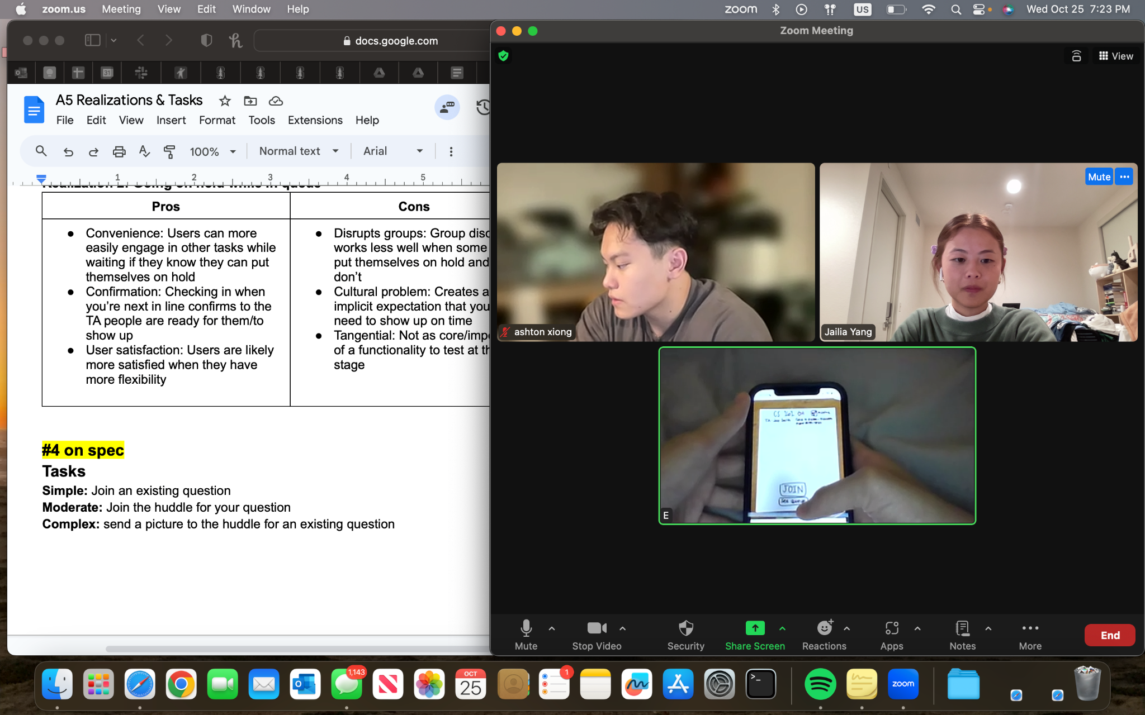
methodology cont.
Figures 9 & 10: Testing C and E through Zoom

Slide 28
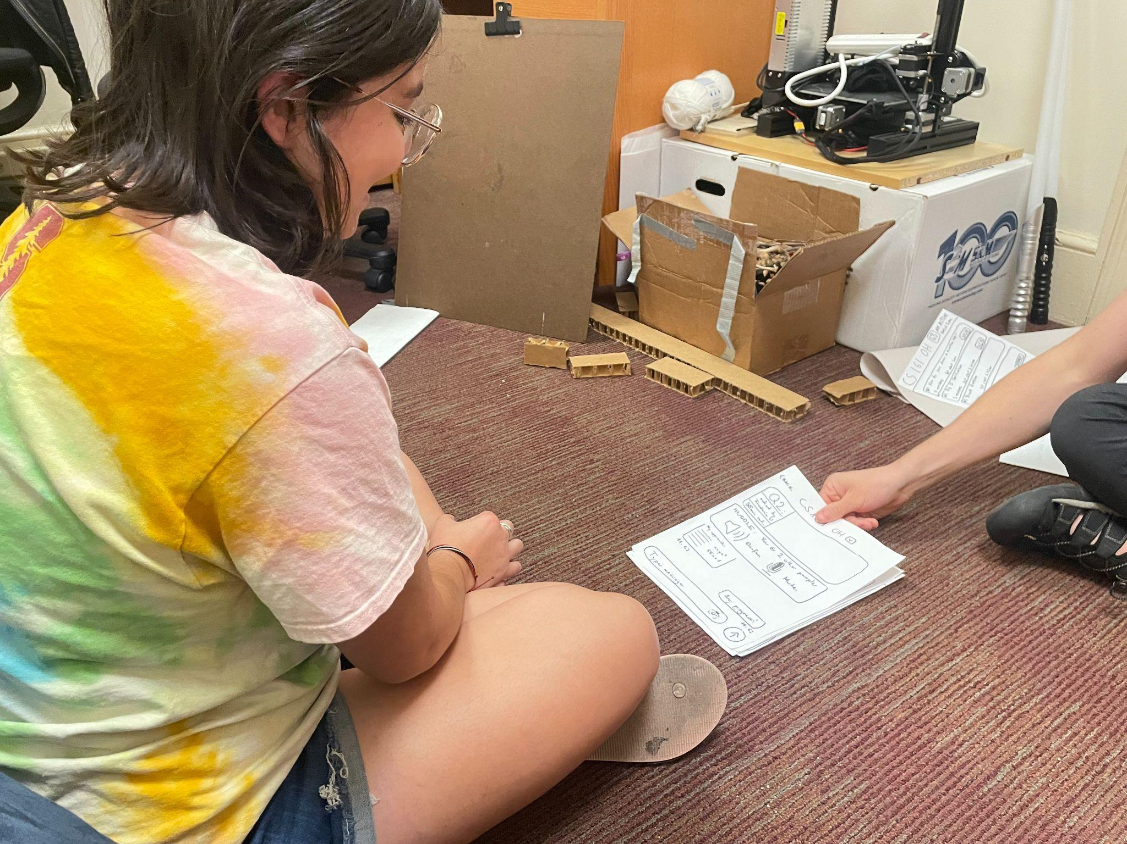
methodology cont.
Figure 11: Testing J in-person

Slide 29
07.
testing: results

Slide 30
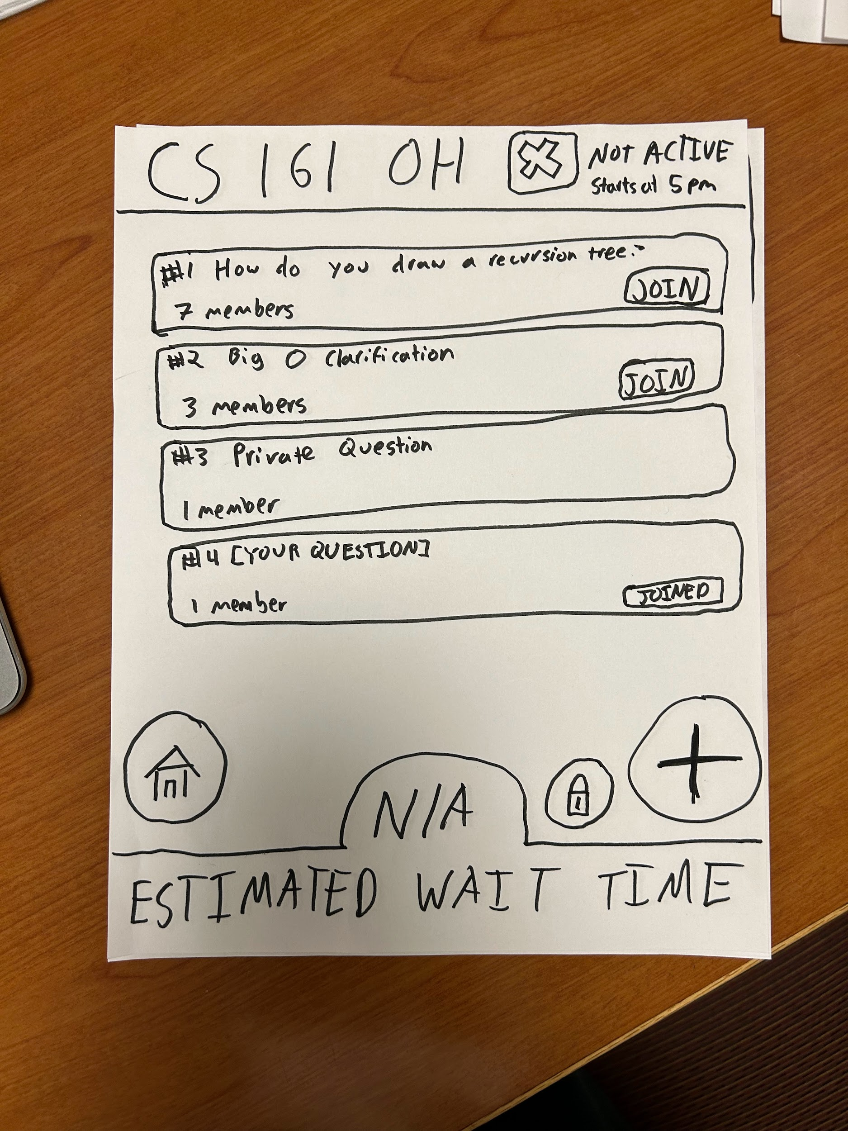
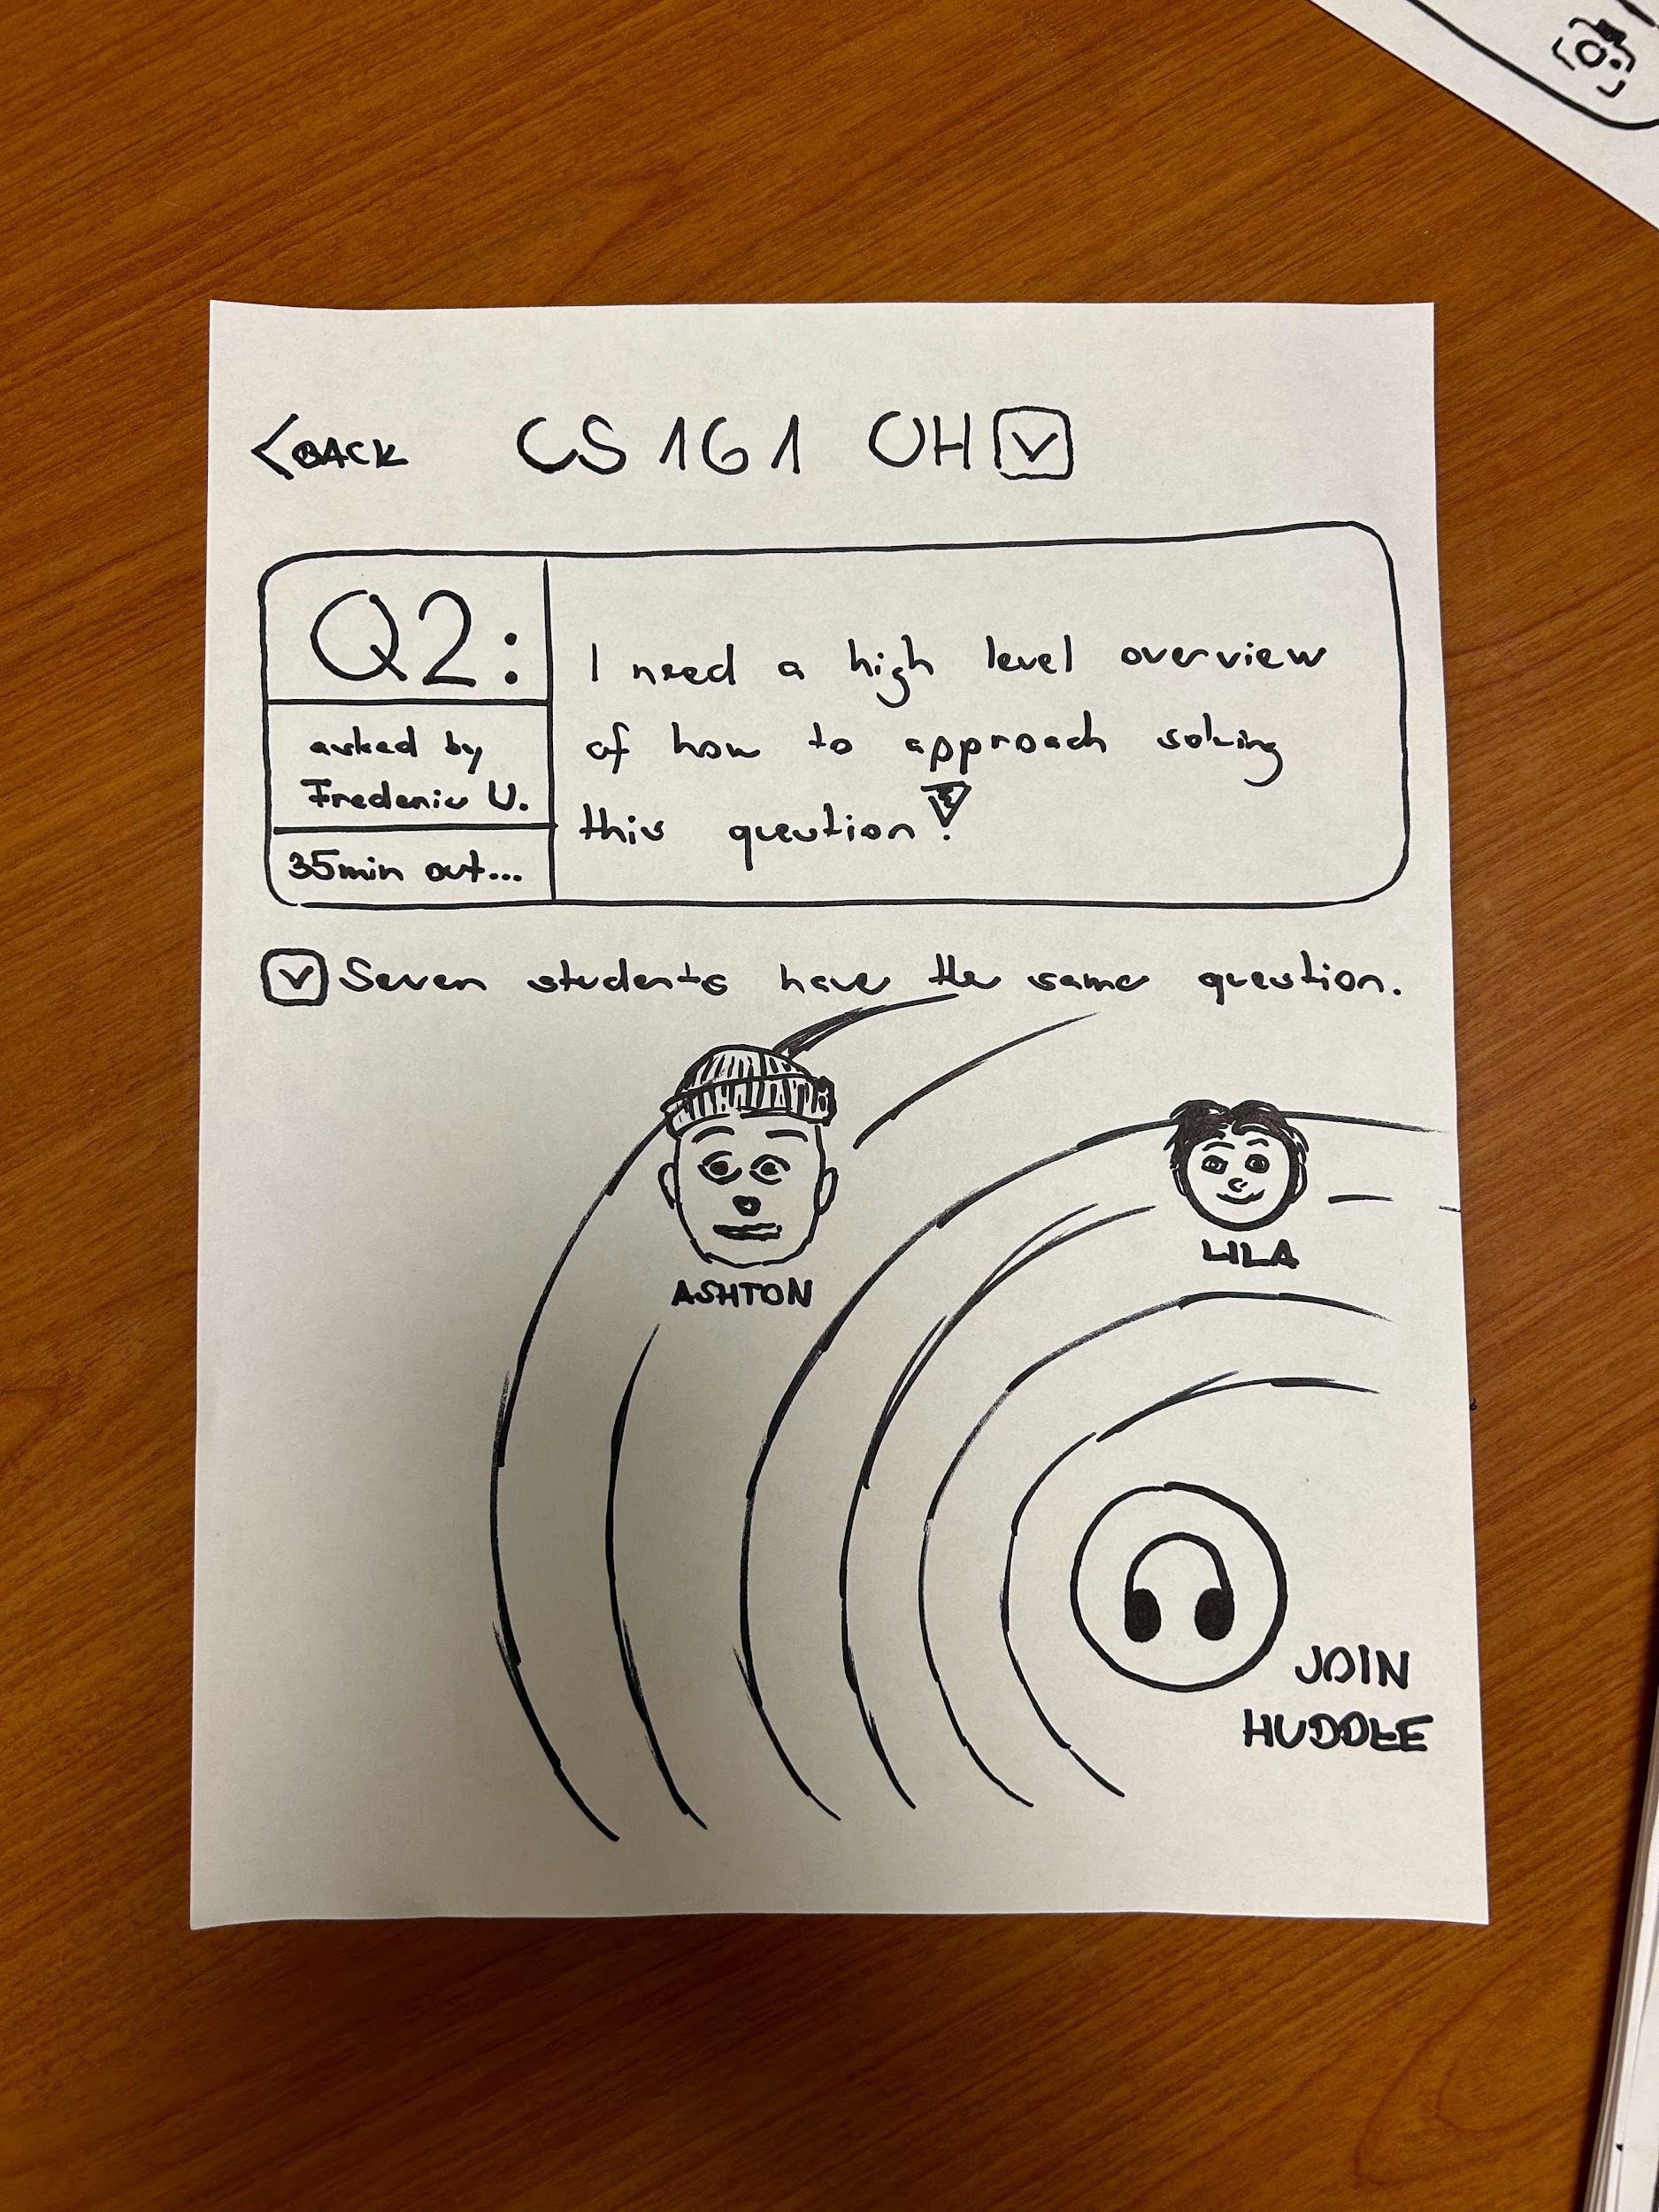

prototype images
bottom-line data
Figure 12: Public questions page
Figure 13: Question specific page
Figure 14: Camera when sending image to chat

Slide 31
data
process data
bottom-line data
Task 1: 18 s, 6 s
Task 2: 51 s, 15.5 s
Task 3: 28 s, 13 s
Confusion with camera
Finding your own question versus other questions
Positive feedback
High task success rates
Low error rates
Notes:
Process data:
First number is average completion time during first round, second number is during second round
In general: Task completion times decreased significantly
A lot of participants were confused about working the camera – The “DONE” button (adopted from iOS camera feature)
All participants hesitated on the question page → Had to guide C and E to “find their question” by reading the available options → Is there a better way to indicate your own asked question(s)?
Bottom-line data:
Generally positive feedback after testing completed
High task satisfaction and success rates → Participants felt like they were knowledgeable enough to navigate through the app and complete the tasks (even during the first round)
Low error rates → Only errors occurred with camera during complex task → After first round, participants made no clicking errors

Slide 32
other observations
participants hesitated on screens with more UI
participants navigated prototype more seamlessly than expected
low-fi prototype usability was inconsistent
Notes:
Other observations and considerations:
Moderate task took the most time to complete
Interesting because “asking your own question” seems like a thing most users would do
Does longer completion time correlate with actual user performance? Does this give us insight into whether or not students would feel prompted to just join a public question instead of going through the extra hassle?
Screens with more UI: Question queue page, question specific pages
Could it be because of the drawings? Would it be different on an actual screen?
Didn’t know what to expect with prototype reactions and navigation
Paper prototype contributed to longer task completion times → averages were only taken from the virtual testing to ensure accuracy
Marvel prototype didn’t work consistently for all Zoom participants
For F, the camera’s “DONE” button didn’t link them to any screen at all
Shouldn’t have been involved in testing, was just an additional feature

Slide 33
achieving usability goals
efficiency
hypothesis: users should be able to complete tasks more quickly during second round → true
task completion times decreased
takeaway: positive user experience when task can be completed in fewer clicks
learnability
hypothesis: users would be able to navigate the app without guidance → true
error rates decreased (minimal to none)
takeaway: app is intuitive and there is no steep learning curve

Slide 34
08.
discussion

Slide 35
implications
user retention
students more likely to attend office hours
increased productivity
decreased task completion times for boosts student productivity
enhanced data insights
reliable and consistent data flow
analytics and insights into student behavior and pain points
Notes:
User retention
Generally positive feedback leads us to believe…Students would be more likely to be open to attending office hours
Not the same experience of having to have a 1-on-1 with instructors if students prefer not to meet in that setting
Students can meet their peers, but don’t have to actively seek them out
Increased productivity
App aimed at increasing student productivity and teacher productivity
Decreased task completion times in order to access office hours features implies that students will be able to be more productive
Enhanced data insights
Simple to begin collecting data → Feature we are hoping to incorporate anyway
Keeping track of which questions are being asked frequently, how many students are grouping for certain questions, how many students are grouping in general → Can help instructors understand student pain points and behavior → Can help instructors gauge how students are interacting with work

Slide 36
testing limitations
real-world context
how students may behave in various locations
emotional responses
subjective feelings not expressed
accessibility and inclusivity
no diverse abilities or assistive technologies
Notes:
Real-world content
Where students are actually located when they are joining OH may impact how they behave
At home, in the car, in Huang basement
Emotional responses
Extension of Zoom testing – Weren’t able to gauge emotional responses to prototype
Asking participants to narrate their behavior as they are learning the app is a lot to ask → Limits their opportunity to truly engage with the app and provide an emotional response
Accessibility and inclusivity
None of our participants had diverse abilities or required assistive technologies
Limited our understanding of how we can make our app more accessible in terms of ethical considerations
We realize that actual students have varying needs → Want to be able to create an app that all students can use → What if schools were to really adopt this technology? How would it impact student populations?

Slide 37
moving forward
make asking a question more direct
E, C, J all shared they want an option to directly submit
simplify how question information is displayed
F, E, C, J all stated they were overwhelmed by UI
J shared that huddle page had too many elements
Notes:
UI changes to make moving forward:
Add an option for users to “Submit Anyways” without prompting them to edit their question
This is a core part of office hours and using the app, so we want to make it as easy and intuitive as possible
Simplify question information
Public questions page: Only include question title → Question information/description can be too much in addition to scrolling through them all
Indicate where your own asked questions are → Highlight, star, separate “My Questions” tab
Huddle page had too many elements → Perhaps in the design of the “huddle,” break the separate components into different pages

Slide 38
09.
appendix

Slide 39
a) Pros/Cons
Mobile Device
Augmented Reality (AR)
Pros
Cons
Pros
Cons
Accessibility: Mobile apps can run on a wide range of devices, so they are more accessible on multiple devices (phone, tablet) and across platforms (iOS, Android, etc.) to a broader audience
User familiarity: Many people are already familiar with using mobile apps, so they are more likely to adopt a new app and the learning curve is less steep
Remote learning: Students are able to collaborate and learn remotely, offering flexibility and encouraging greater use of the app
Screen size constraints: Mobile apps are run on smaller screen sizes, thus less content can be displayed and certain interactive features may be more difficult
Distractions: Mobile apps can serve as a distraction, so it could affect the focus and quality of collaboration between students
Less applicable to certain fields: Subject areas (chemistry, field work, etc.) that require a lot of physical interaction or manipulation are difficult to replicate due to the lack of physical interaction capabilities
Immersive collaboration: Students can feel like they are actually together in-person, thus creating a more interactive and immersive learning experience
Visual learning: AR can enhance visual learning through overlays, diagrams, popups, etc.
Hands-free learning: AR enables hands-free learning (ie glasses) which allows students to interact and engage with content and peers more easily
Device compatibility: AR apps require specific and more advanced hardware, thus access is limited (especially if technologies are being provided by schools)
Learning curve: Most people have little to no experience with AR, so it can be a barrier to adoption
Privacy concerns: Camera and location tracking raises privacy concerns especially in educational settings with minors

Slide 40
b) Lo-Fi Prototype
https://marvelapp.com/prototype/309b631g/screen/93024673

Slide 41
c) Script
Introduction:
Welcome to our app prototype testing! We want to make it clear that in this session, we are testing our application, not you. There are no right or wrong actions, and your valuable input will contribute to our study's success. Your participation and feedback are essential in helping us refine and enhance the user experience of our app.
Task 1:
First we would like for you to try and join an existing question.
Task 2:
Next we would like for you to create a question on your own and then join that questions huddle.
Task 3:
Finally, we would like for you to join a question’s huddle and submit a picture in the huddle chat

Slide 42
d) Notes/Logs
Interview Notes:
https://docs.google.com/document/d/19BOObUJv5r42L0ziPciaK9pQeV29YZsEsxbAEWwdq6o/edit
https://docs.google.com/document/d/1YmlZG2yM8AEYaeloUmE4HPidIkwLxs0RuHlF7BGau_M/edit
https://docs.google.com/document/d/16qhJbO6kCRR30evu3MihAOiIpQpq8Iz9uq9XJrjr060/edit#heading=h.f3mnuwyfgbud

